Slide 1
Welcome to the Lunch and Learn!

Slide 2
AGENDA:
Welcome, Introductions
District Customer Stories:
Spokane Public Schools
Wenatchee School District
Bellingham School District/Meridian School District
Qualtrics in K12
Closing/Building Tour

Slide 3
Qualtrics Introductions
Ryan Case
Mike Powell
Patrick Mahaney
K-12 Enterprise Account Executive
CA, WA, OR,
K-12 Account Executive
WA, UT, CO,, NE, KS, LA
K-12 Solutions Engineer
Notes:
Focus of Qualtrics introduction:
We have experience in and are aligned to K-12
We are in K-12 & education because we love it
What makes us happy is to make an impact for students, families, teachers
Meeting the customer team:
What is their role?
What is their scope of influence/interest?

Slide 4
XM For K-12 Education
Notes:
Katie will talk through some IL use cases and then intro Kaela from Woodridge.

Slide 5
Spokane Public Schools
Notes:
MADI

Slide 6
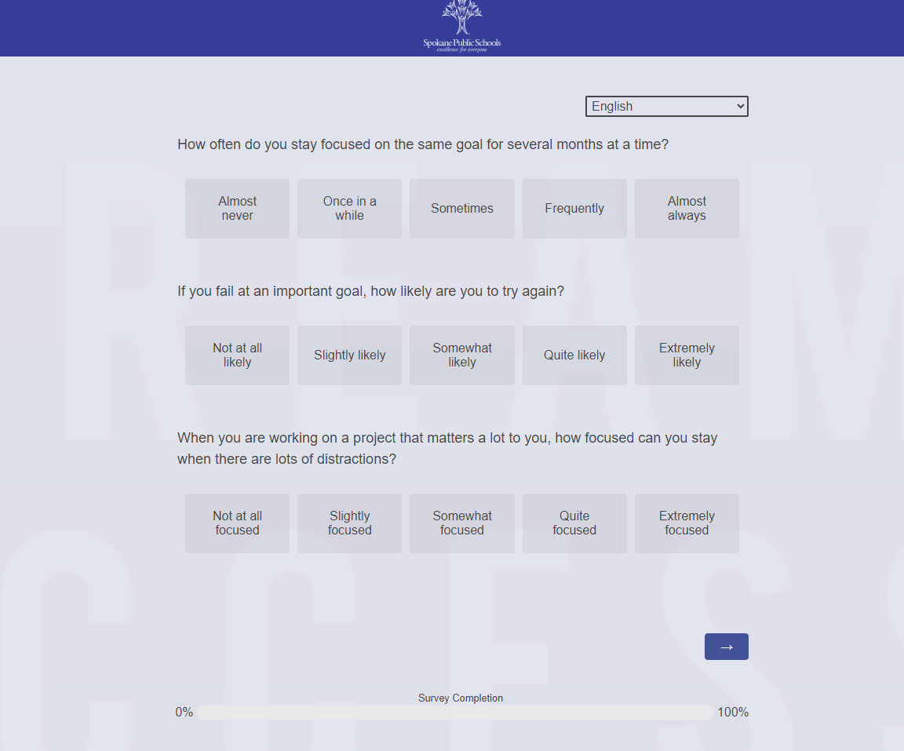
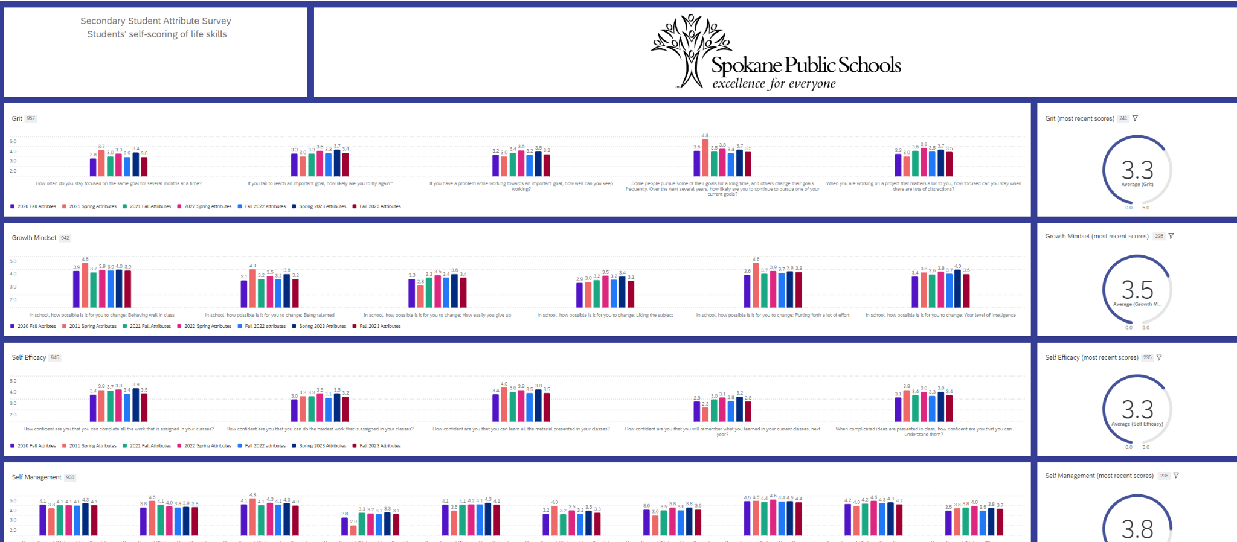
Panorama SEL Survey Transition
Panorama Surveys: Elementary/Secondary Student Attribute, Student Climate, Teacher Climate (Fall & Spring)
Window-to-window comparison, “live” lists of students/teachers with low completion, highest/lowest questions & categories
Authentication to capture directory demographics for students/teachers. Dashboard filter views for whatever is needed
Translation options

Slide 7
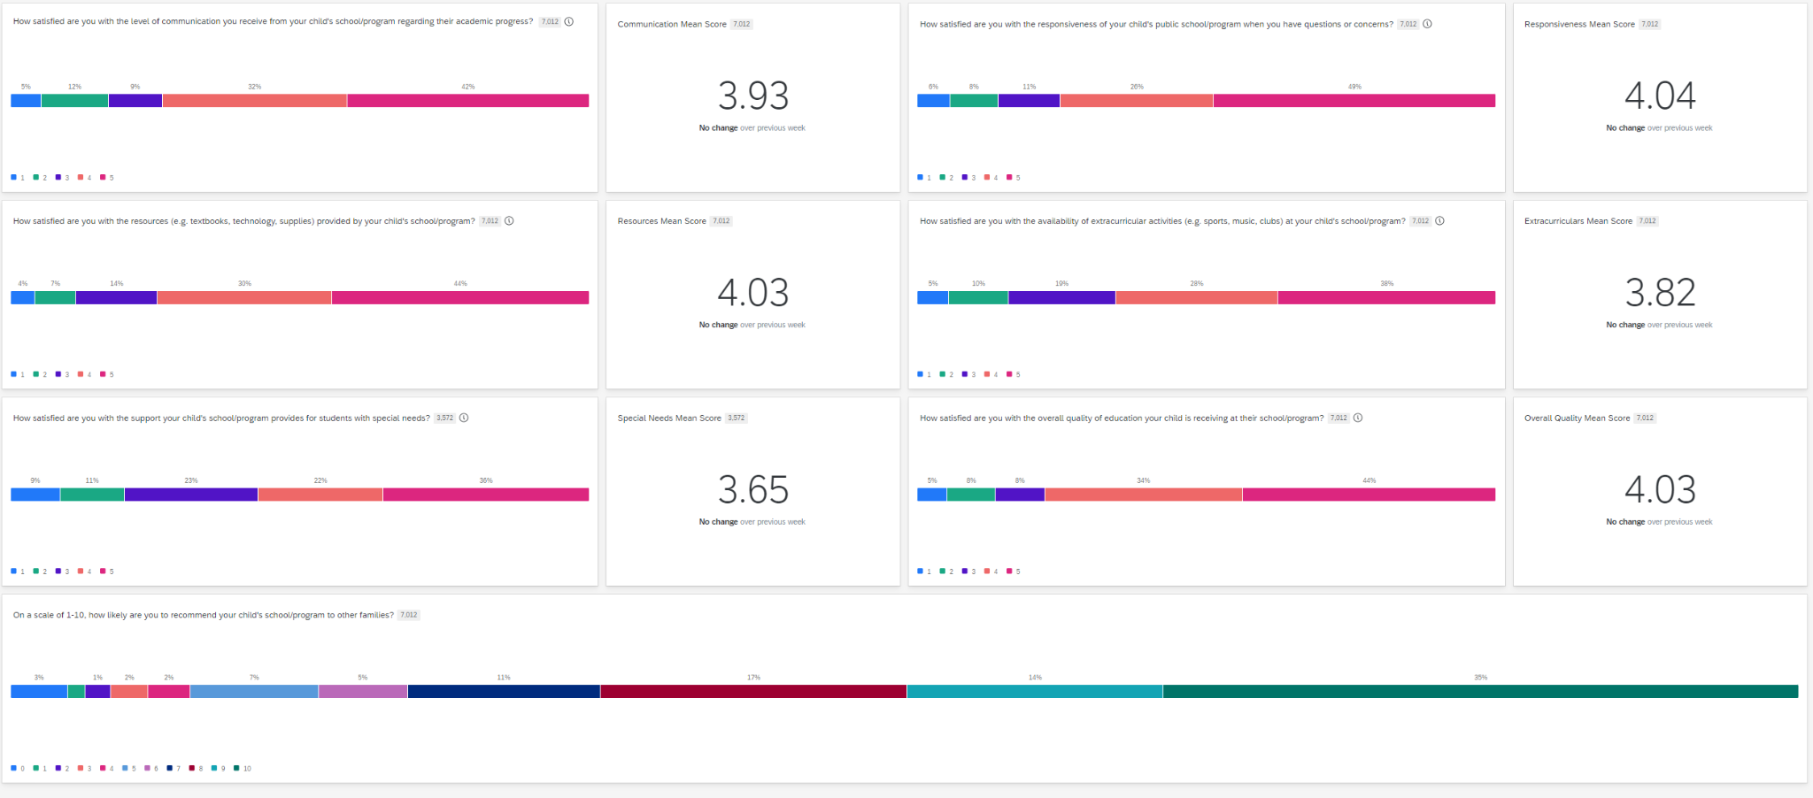
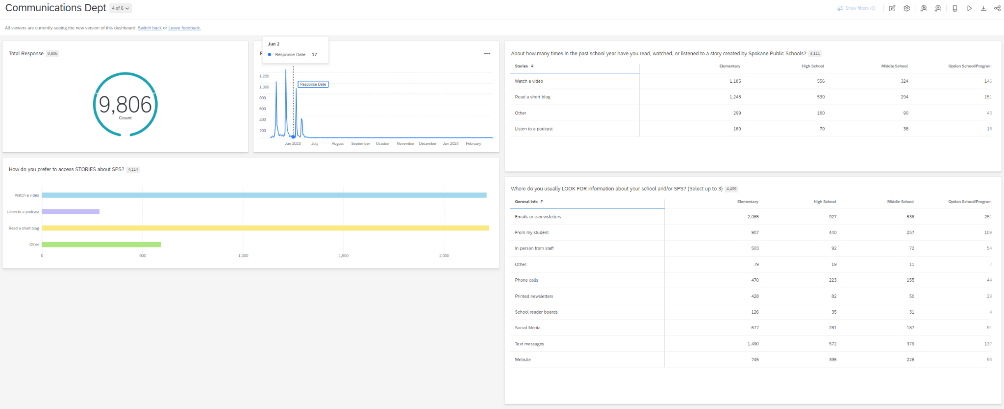
Family Survey [QSF]
Panorama Family Survey -> Qualtrics Survey
~99 to over 9,000 responses
Communications Dept. leveraged questions about where families get information, % of families in support (8 or higher on 1-10 scale) for bond/levy messaging.

Slide 8
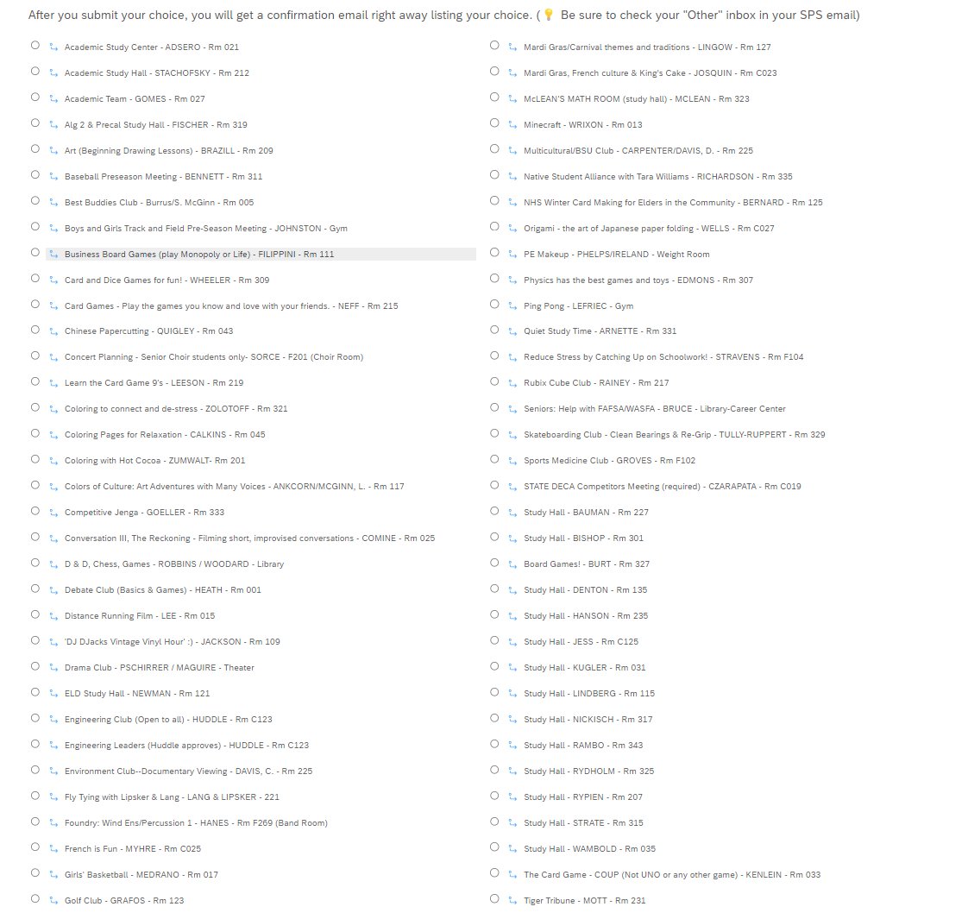
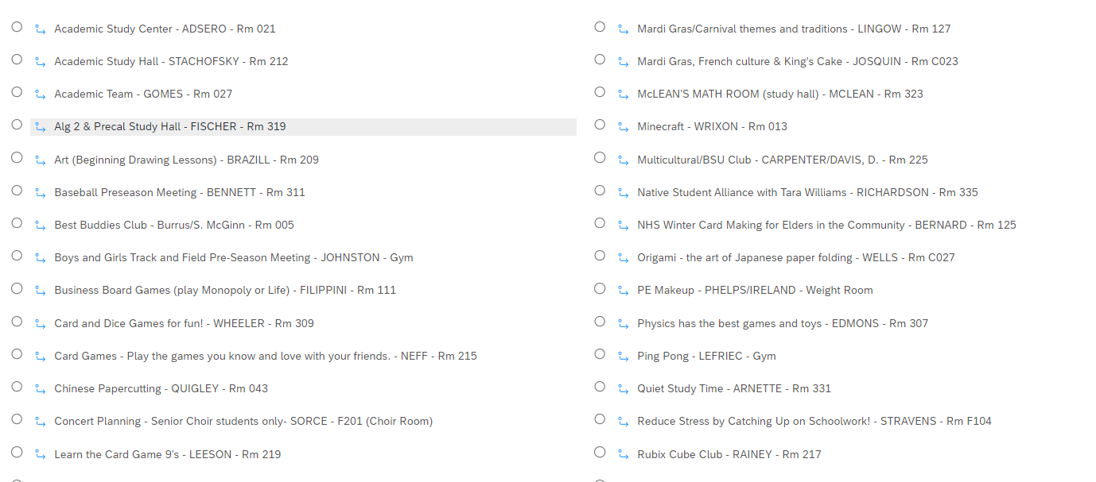
High School Advisory - “Connect Time” [QSF]
Re-establish relationship building between teachers and students for Advisory
Teachers create offerings based on their own interests
Students sign up for those offerings
Quota function makes choices disappear when full.

Slide 9
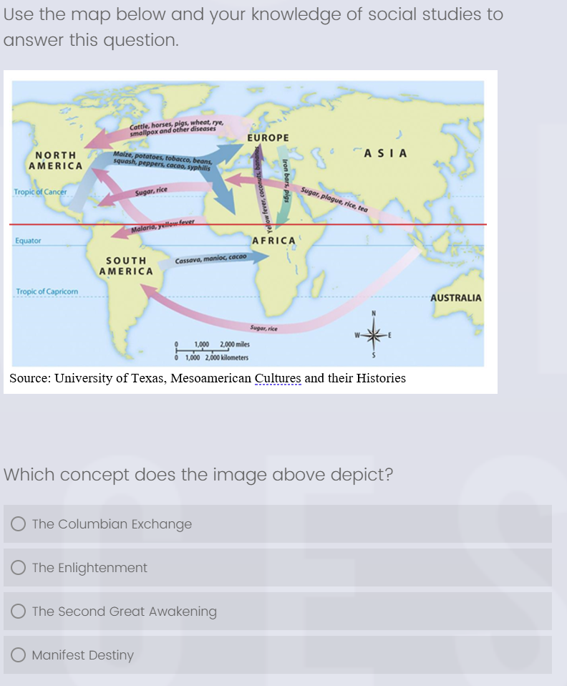
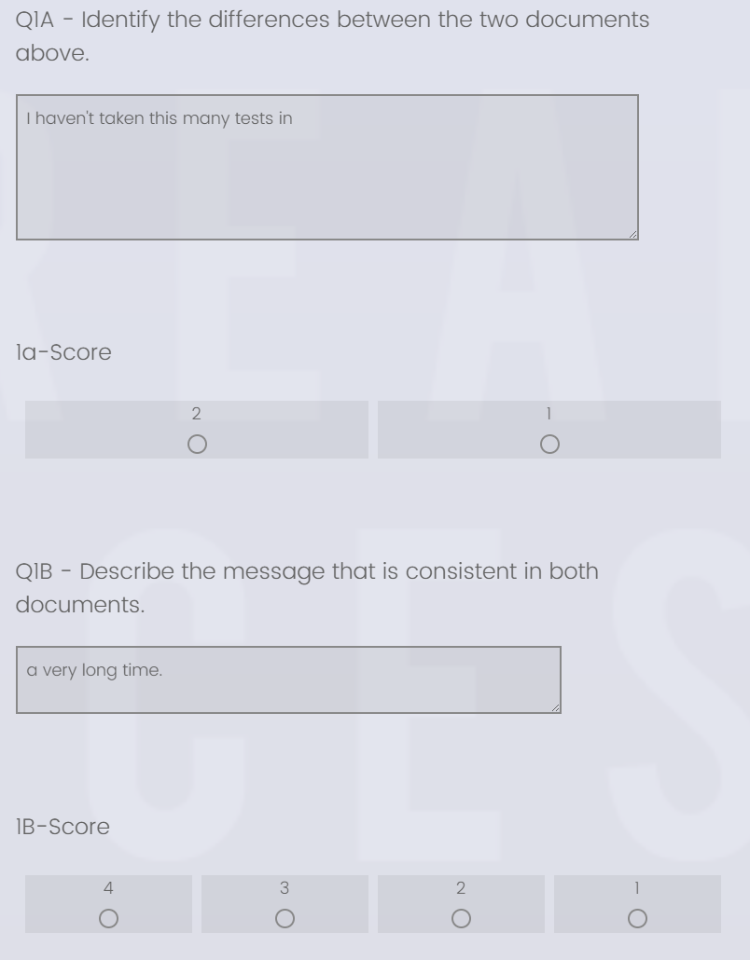
End of Semester Assessments - Mastery-Based Learning
Multiple Choice
Extended Response - Teacher Score
Multiple Choice [QSF] and “Extended Response” [QSF]
MC is auto-score, ER has “retake” link function so teachers can see students’ answers and score
Dashboard shows QXQ analysis and overall scores

Slide 10
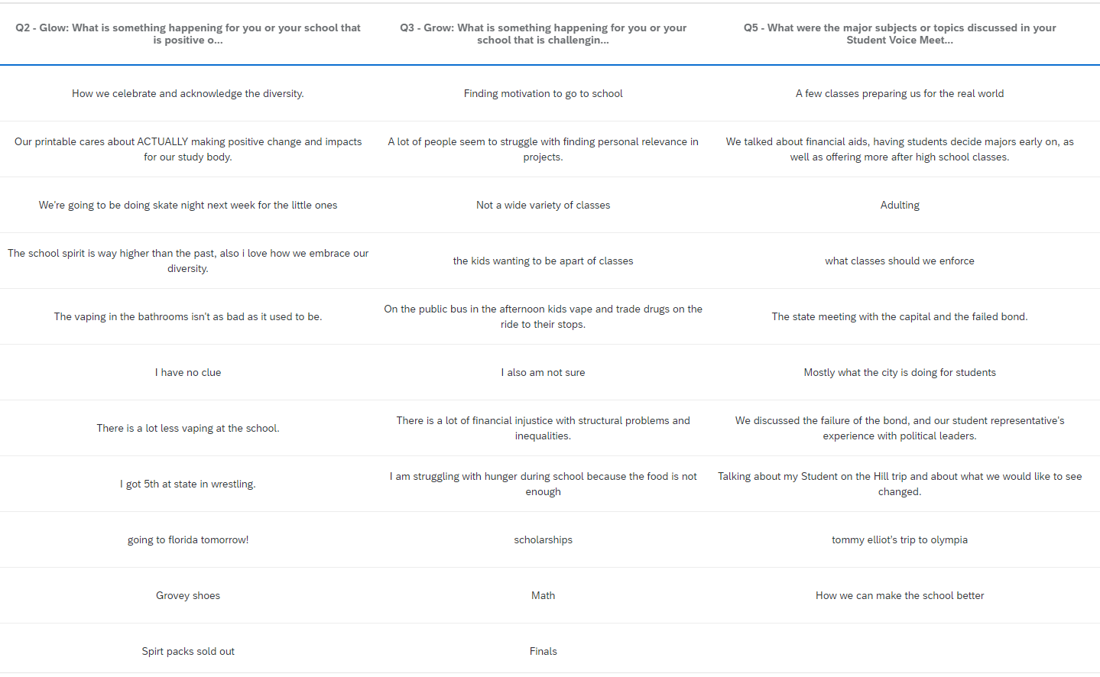
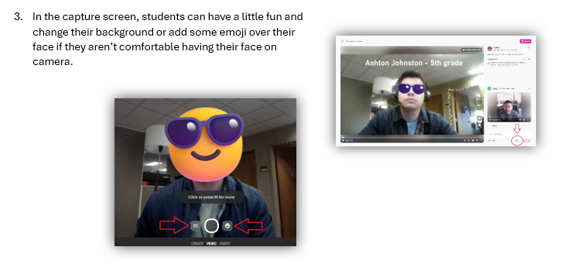
Student Voice [QSF]
Student Voice Full Guide
Each building has a monthly student voice meeting
Periodic district student voice meetings
HS = Quick survey to capture student voice for Student Advisory to the School Board to report to the School Board
MS - Elementary - Transition Support (AMA via Flip.com)

Slide 11
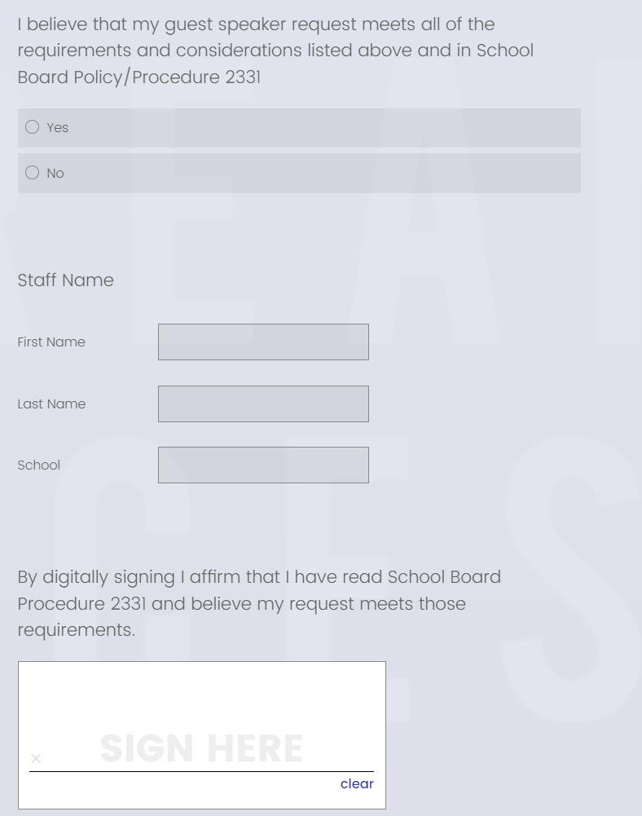
Guest Speaker Approval Process [QSF]
Teacher Guide
Teacher reviews School Board Procedure
Teacher submits request to principal (auto-email to principal)
Principal reviews teacher submission and approves/denies
Teacher receives email with decision
“Re-take link” function helps keep all function in one project

Slide 12
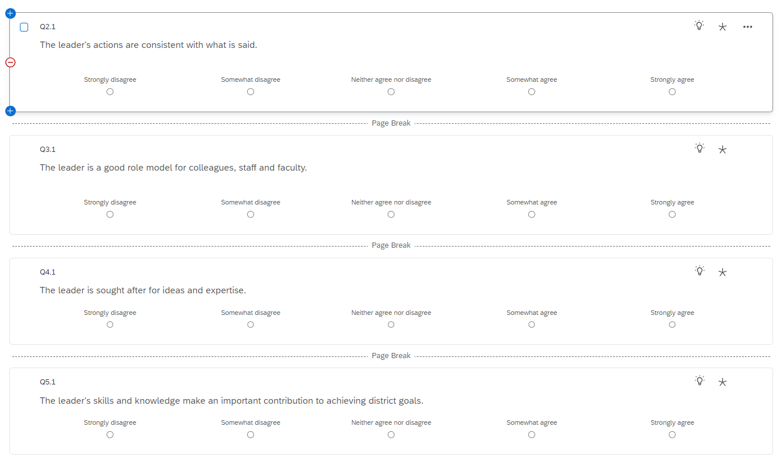
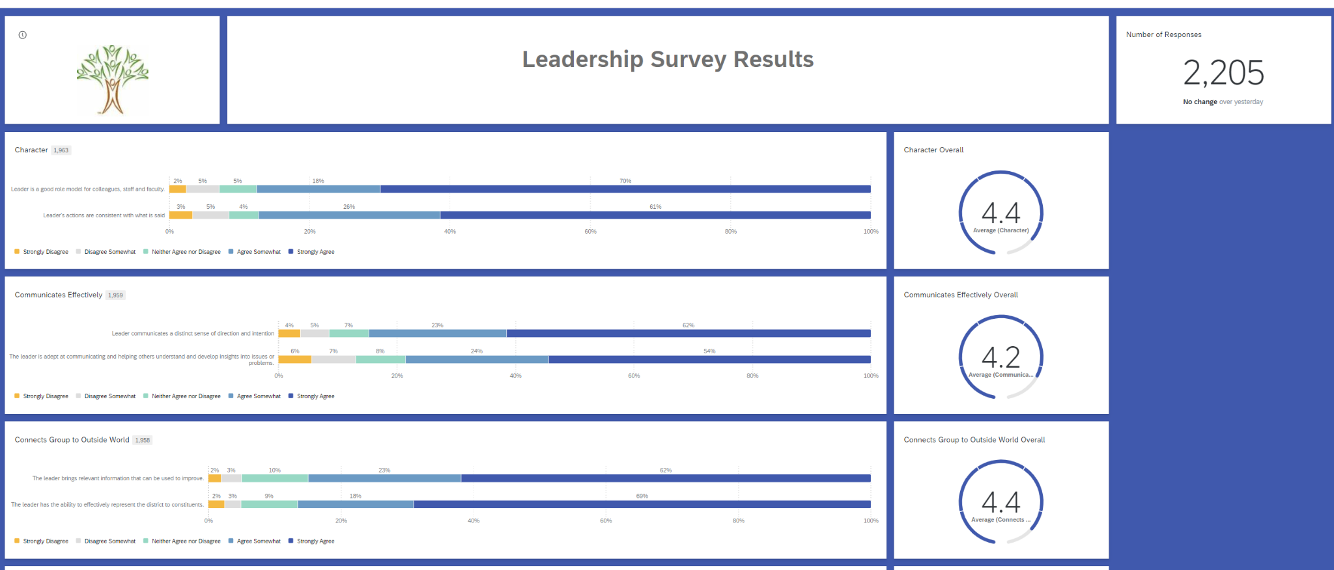
District Leadership Survey [QSF]
Based off of Zenger-Folkman
Directors, Exec. Directors, Chiefs, Superintendent
Anonymous
Deliberate about not everyone answering for everyone

Slide 13
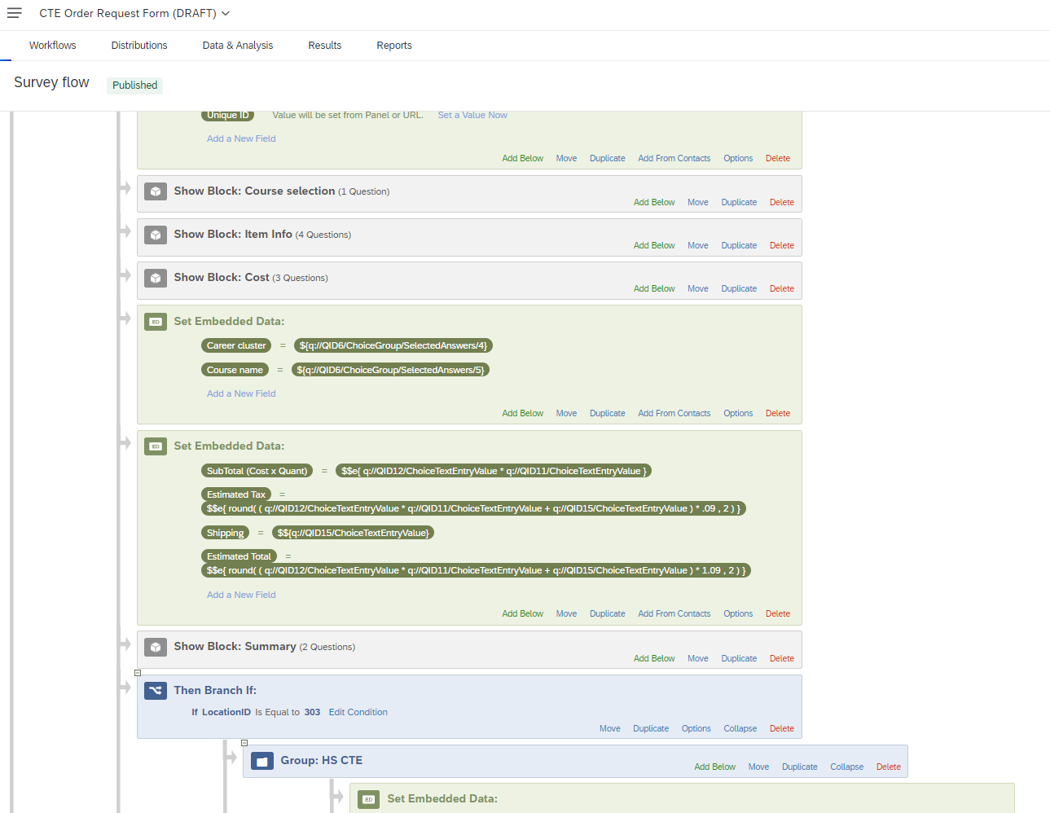
CTE Ordering (Ticketing)
CTE Teacher in-building wants to order something:
Information collected “automates” estimated costs based on quantity and tax
Route to CTE Department Lead or District CTE admin based on cost for approval
Once approved - the teacher gets an email of the approval and that it is being ordered (District CTE Office Manager orders)
Curriculum and Instruction brainstormed if this would help classroom teacher request for curriculum to warehouse to classroom, etc.

Slide 14
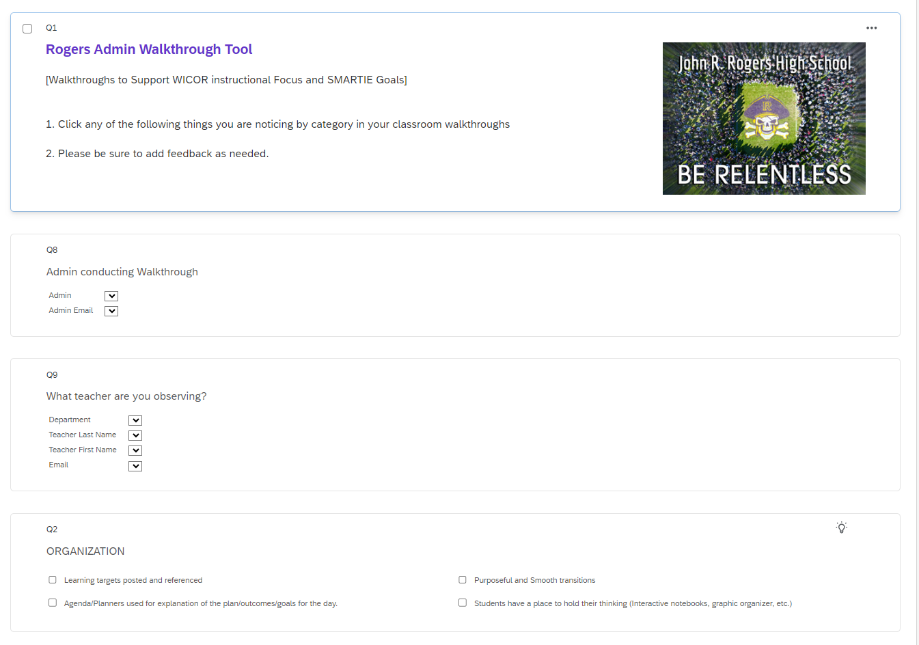
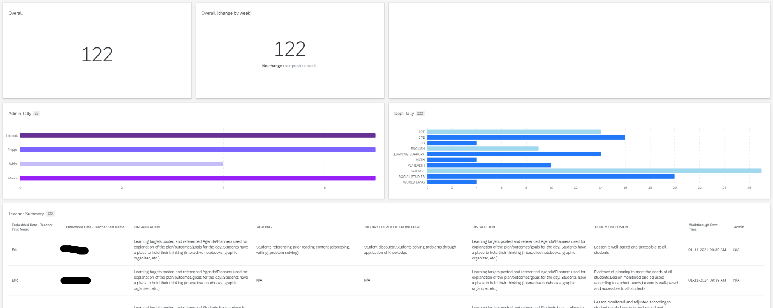
AVID Admin Classroom Walkthrough [QSF]
Support Admin/Teacher calibration on WICOR Strategies being used/observed in the classrooms.
Create friendly competition for admin to get out in the classrooms.
Drill Down to help automate email summaries to teachers and cc supervising admin

Slide 15
Digital Signature
Guest Speaker Approval
Change in Immunization Recordkeeping
Legal has said include the following:
Consent Statement
Consent-Agreement Selection (Yes/No)
Staff Name
Digital Signature

Slide 16
Qualtrics Wishlist
ALE Compliance Forms:
WSLP
Weekly / Monthly Contact Logs
Intervention Log
Facilities Job Request (Athletics)
School Map - Heat Map
HR - Paper Form conversion (Building Volunteer/Part-Time Employment, Reference Check forms, etc.)
1-5 SEL Emoji Survey
Automation for “1s”
Athletics/Activities (Engagement Check-in Tool)
Video Response?
“Re-take” link functionality to eliminate multiple projects for one purpose

Slide 17
Wenatchee School District
Notes:
MADI

Slide 18
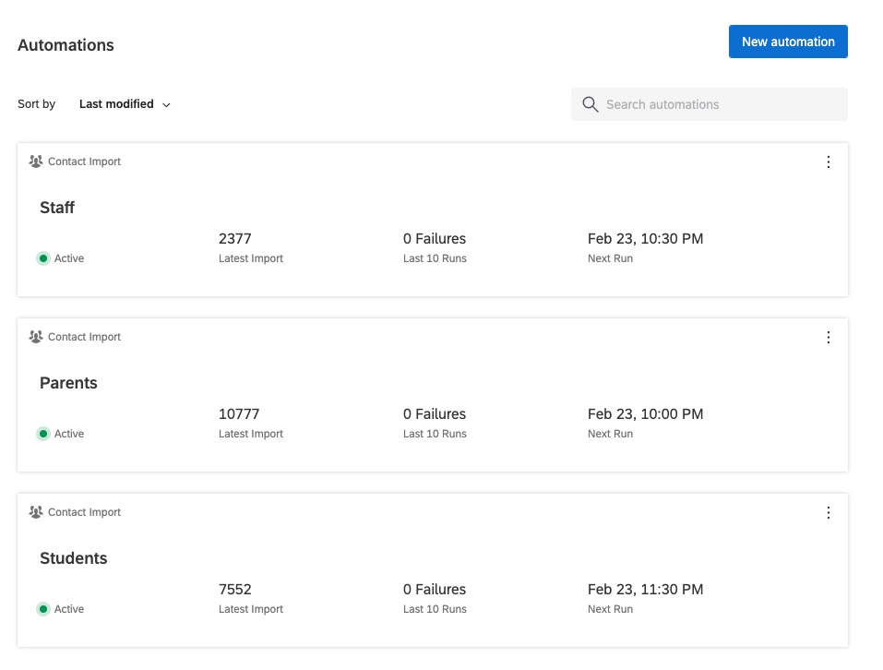
Directory and Segment Automations
Import nightly directly from Skyward Student Information System using Skybuild.
Rich staff and student data.
Parent contacts are used for survey distributions.
Notes:
The automation from the student information system is crucial to get the right surveys to the right people. In addition syncing allows us to do protected dashboards, surveys, and other analysis with the demographic data from our staff and students. We import roles, demographics, assignments, titles, etc.

Slide 19
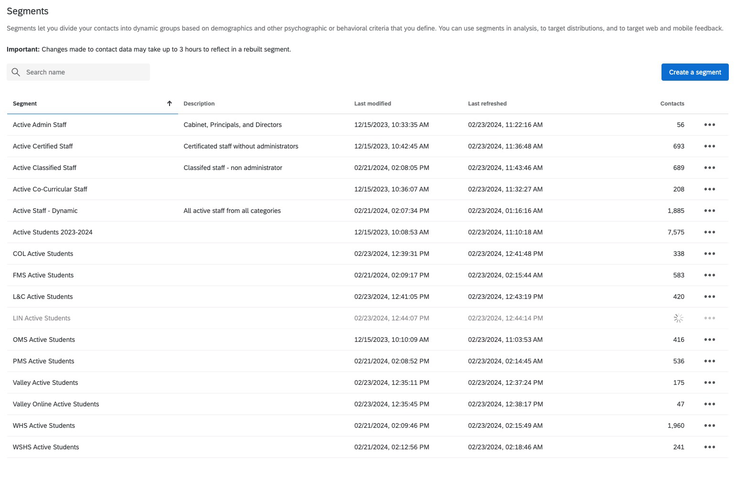
Directory and Segment Automations
Segments are automated off of the imports for use in surveys and to align demographic data for analysis.

Slide 20
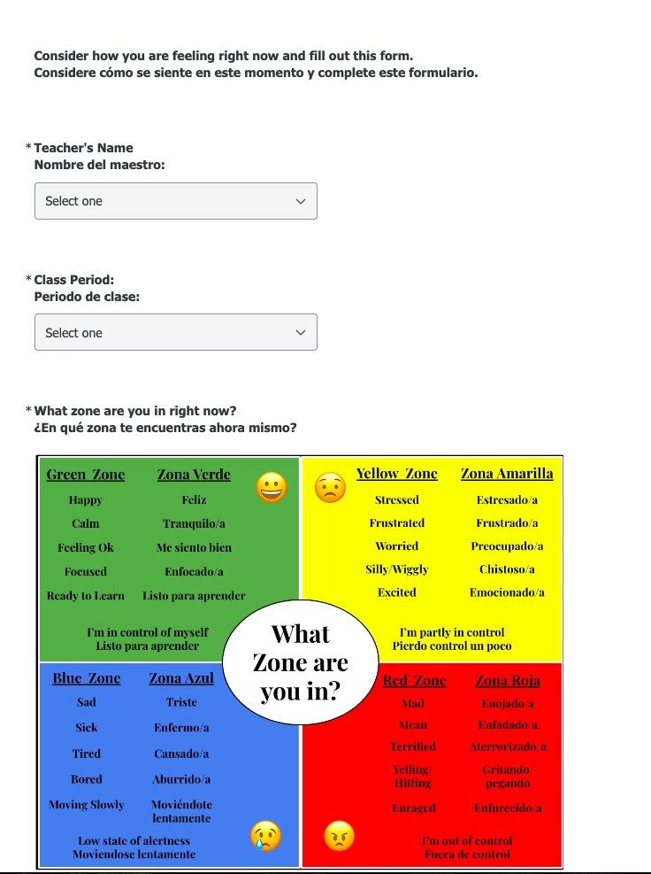
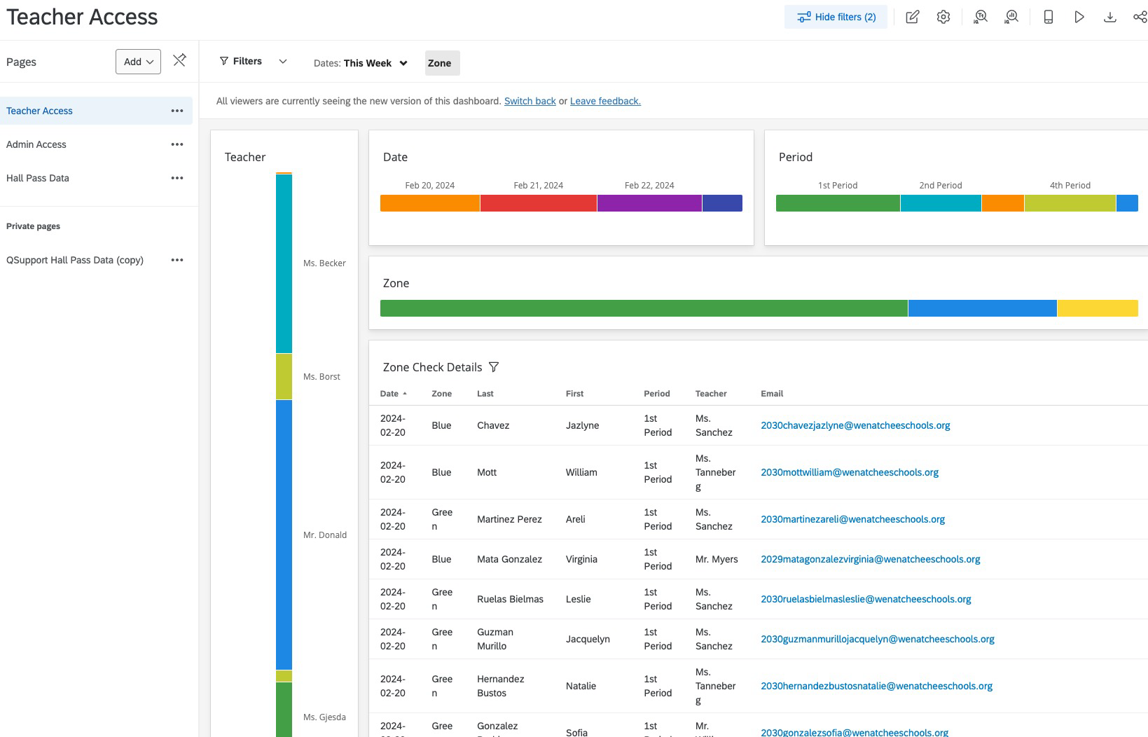
Social Emotional Learning Zones of Regulation Check and Dashboard - - QSF & WF
Notes:
Several schools do some sort of regulation check of their students daily and in some locations every period. This automated workflow allows students to speak up and get the help they need for a variety of issues.

Slide 21
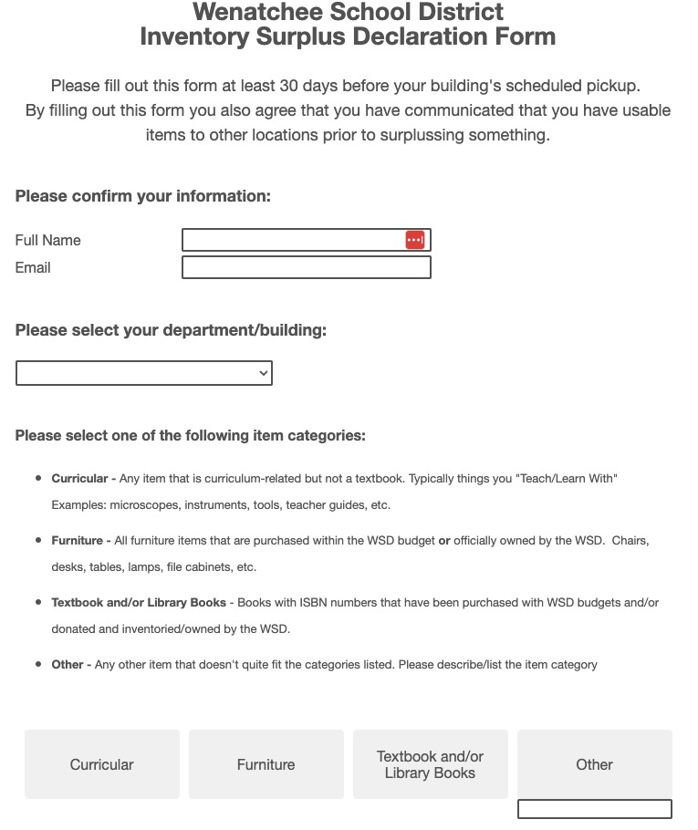
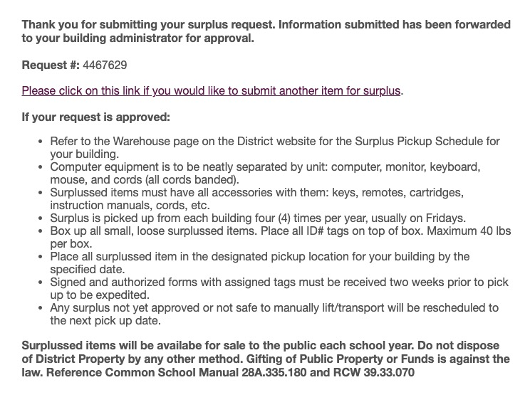
Surplus Processing Electronically and Efficiently - QSF
Notes:
Custodial and other staff process surplus at each site with a tablet. They input their data along with photos. Once it is collected it gets processed, and goes to an internal sharing site as one person's junk is another person's treasure, after this posts for two weeks, a list goes to our board for approval, once it gets approved, a list automatically goes to our ESD and a list of private schools in the area, after that for 30 days, we post many of the bigger things to GovDeals Auction, then finally we ecycle, dispose, sellback, trade in, and keep some for an annual surplus sale.

Slide 22
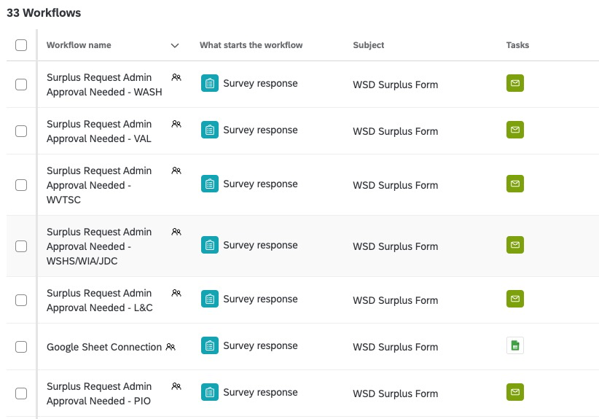
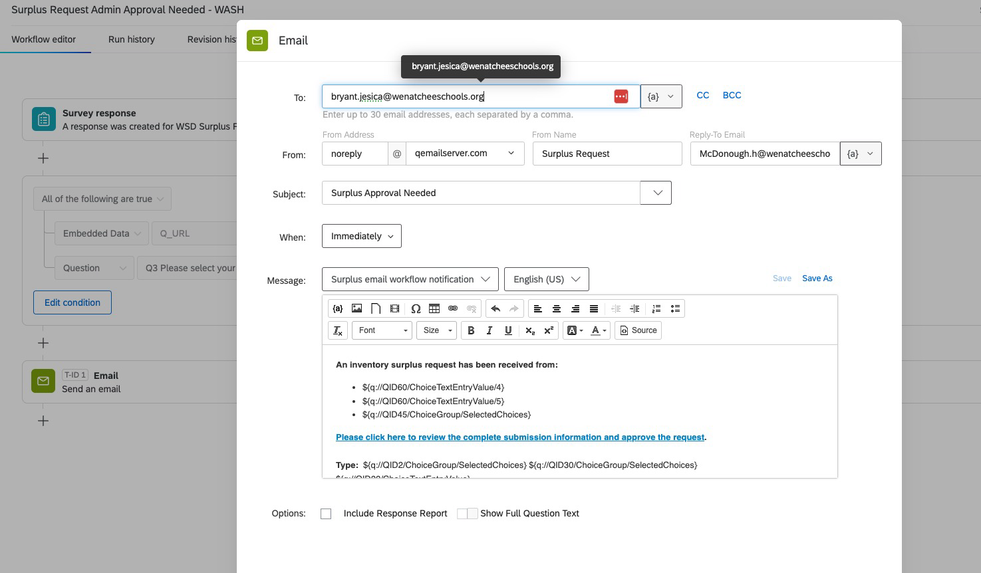
Surplus Processing Electronically and Efficiently
Notes:
Customized for approvals, routing, and connected to a Google Sheet for post submission processing.

Slide 23
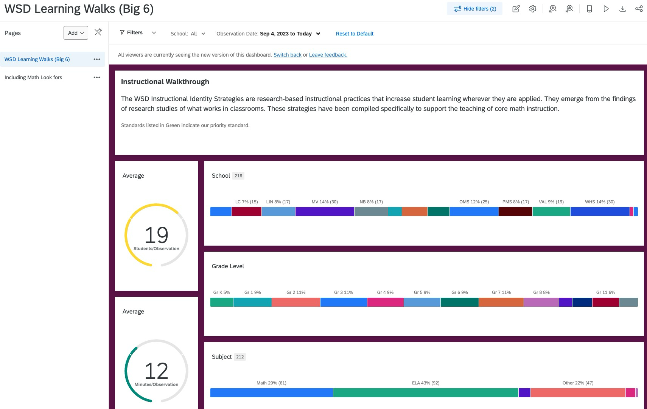
Classroom Walkthrough form with dashboard aligned with our KPI, Marzano Framework for instructional strategies, structured literacy, math identity, and teacher evaluations. culture- QSF
Branches if they want to include structured literacy
Branches if they want to include mathematics identity
Branches to choose the standards being observed
All aligned with Marzano Framework
Data feeds our improvement efforts

Slide 24
Other Wenatchee Projects
Annual Culture and Climate Survey for parents, staff, and students - QSF
Facilities use request from internally and external groups. - QSF & WF
Exit surveys for staff - QSF
Field trip requests - QSF
Student registration - QSF
Professional development sign in - QSF
Hall passes - QSF
Awards and recognition certificates
Athletic Interest Survey - QSF
Volunteer Application - QSF

Slide 25
Bellingham Public Schools & Meridian School District
Notes:
MADI

Slide 26
School Climate Survey
Project purpose
Survey families, staff and all students in grades 3-5; 6-12
Generate dashboard data for leadership response
Look at data over time
Key features
Three dashboards for access types

Slide 27
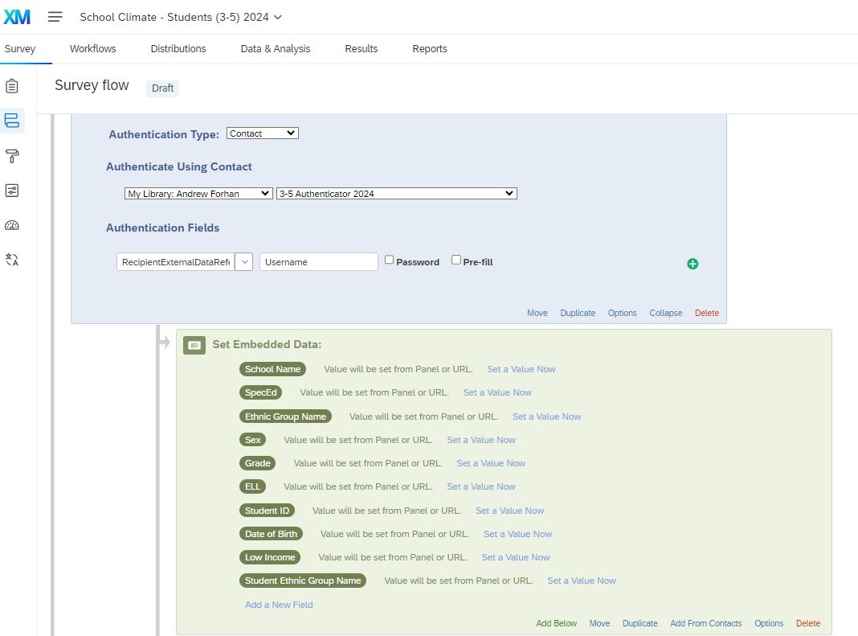
School Climate Survey

Slide 28
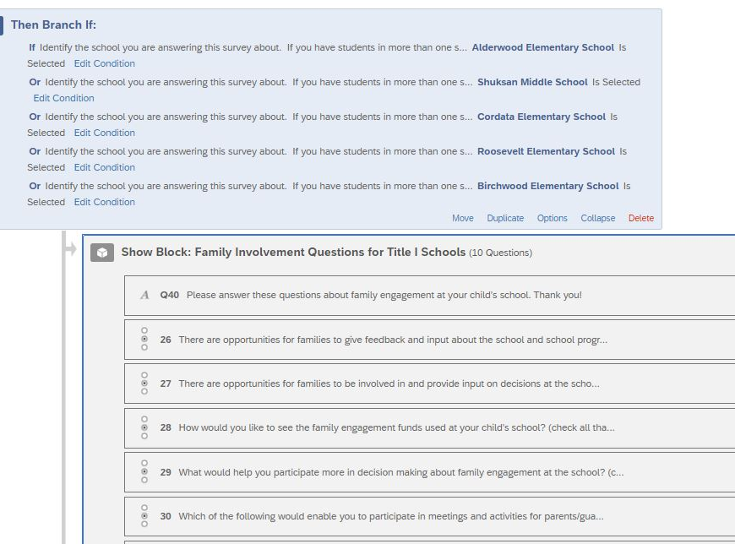
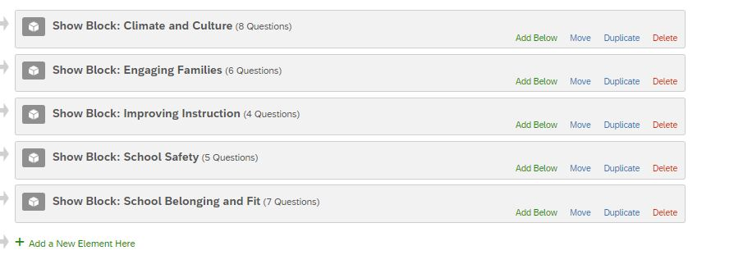
School Climate Survey

Slide 29
School Climate Survey

Slide 30
School Climate Survey

Slide 31
School Climate Survey

Slide 32
GREW Waiver - multi-step approval
Project purpose
Assist with graduation emergency transfer requests
Key features
Two-step approval process with counselors submitting, principals approving

Slide 33
GREW Waiver - multi-step approval
GREW Waiver - multi-step approval

Slide 34
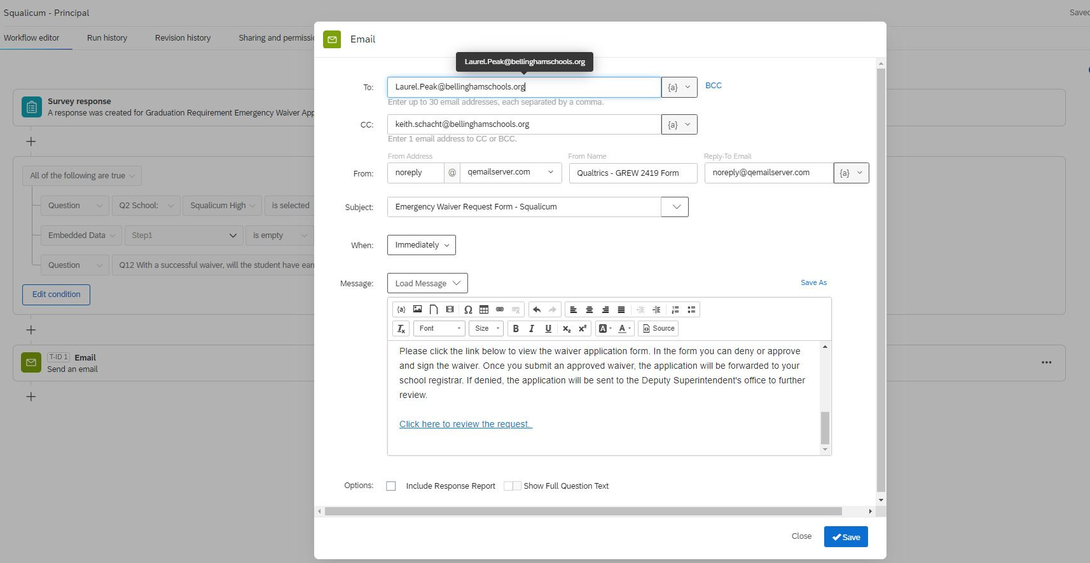
GREW Waiver - multi-step approval
GREW Waiver - multi-step approval

Slide 35
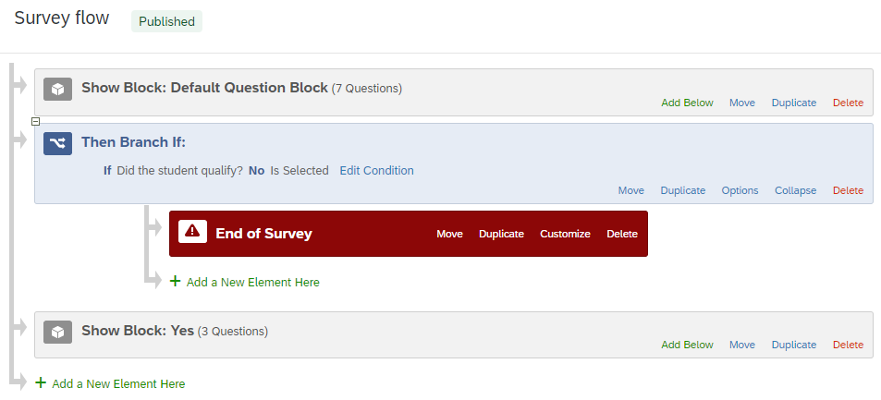
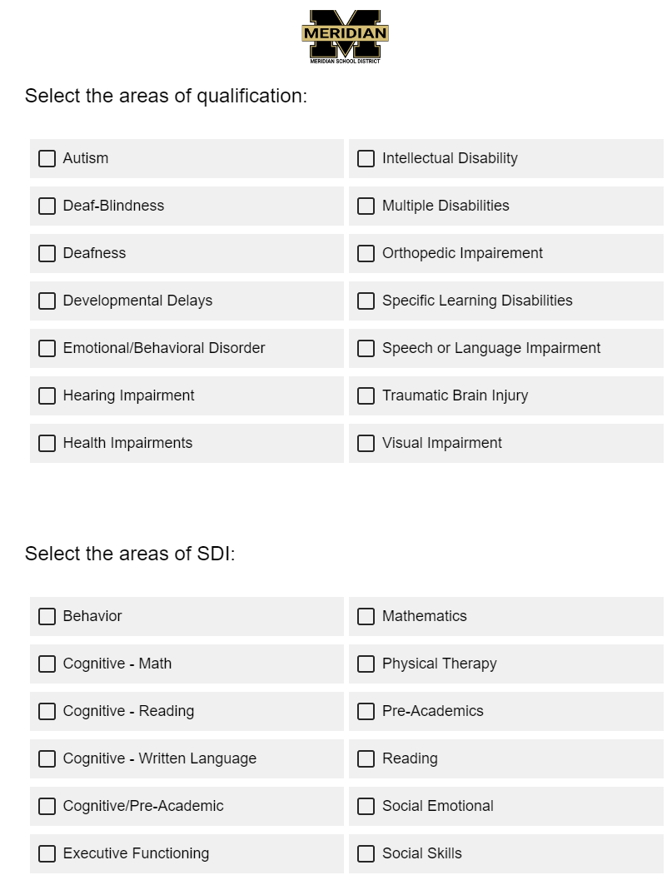
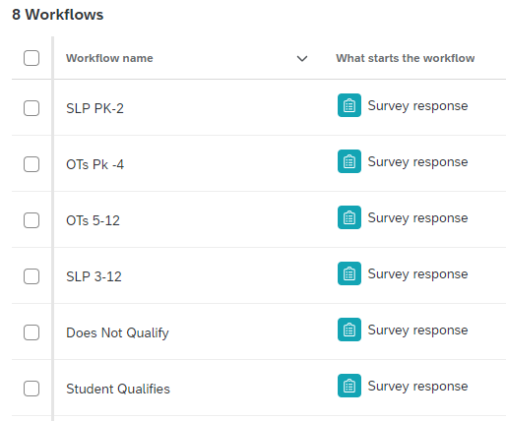
Meridian - Eligibility Form

Slide 36
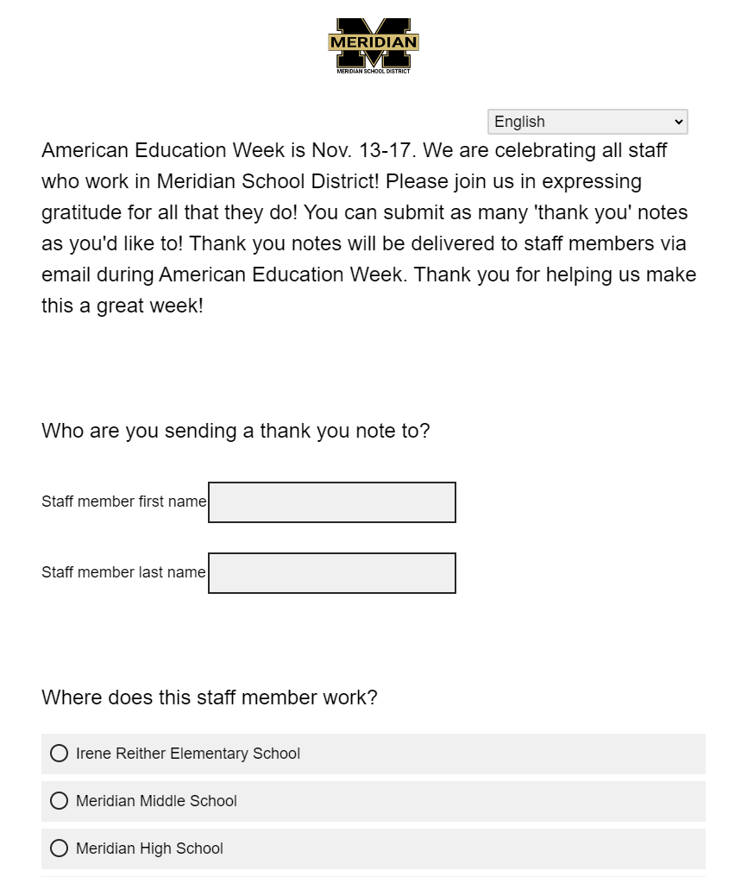
Recognition - Meridian

Slide 37
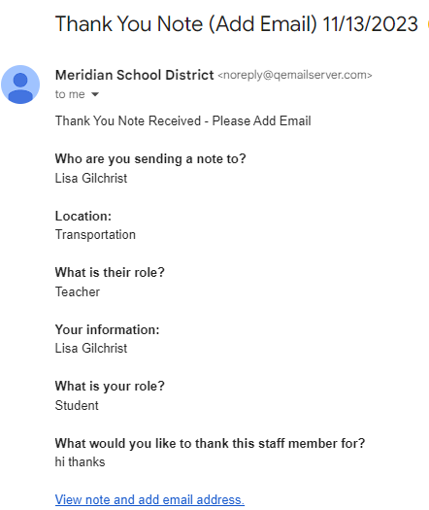
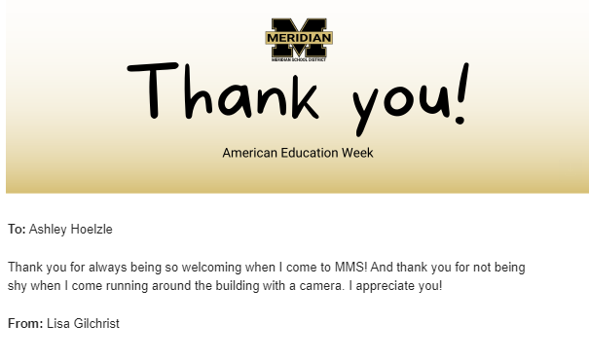
Recognition - Meridian

Slide 38
Meridian
Field Trip Form
School Board Inquiry Form
Budget Survey
Calendar Survey
School Referral Form
Senior Exit Survey
Coach Training Form
Interpretation Request Form (families and staff)
Interpretation Feedback Form
Annual Awards Submission Form
Student Spotlights - QSF

Slide 39
X4 is back in 2024!
Landing Page
Promo Code: X4PUBSEC499
Notes:
2 hour meet and greet, and 2 hour reception
6 k12 sessions

Slide 41
Q&A

